Slide 1

Identifying the Optimal Hub for Efficient Snow Removal in Montreal
MGSC-662-076 - Group Project - Group 5:
Jaya Chaturvedi, Krishan Gupta,
Rodrigo Castro Canal, Syed Ammad Sohail,
Yash Joshi

Slide 2

Introduction
Project Purpose:
Optimize snow removal in Montreal.
Identify cost-effective central hub for operations.
Importance:
Critical for safe, accessible city during winter.
Supports sustainable urban planning.
Context:
Montreal's 2021 snow removal cost: $179.7 million.
Aim: Reduce costs, improve efficiency.

Slide 3
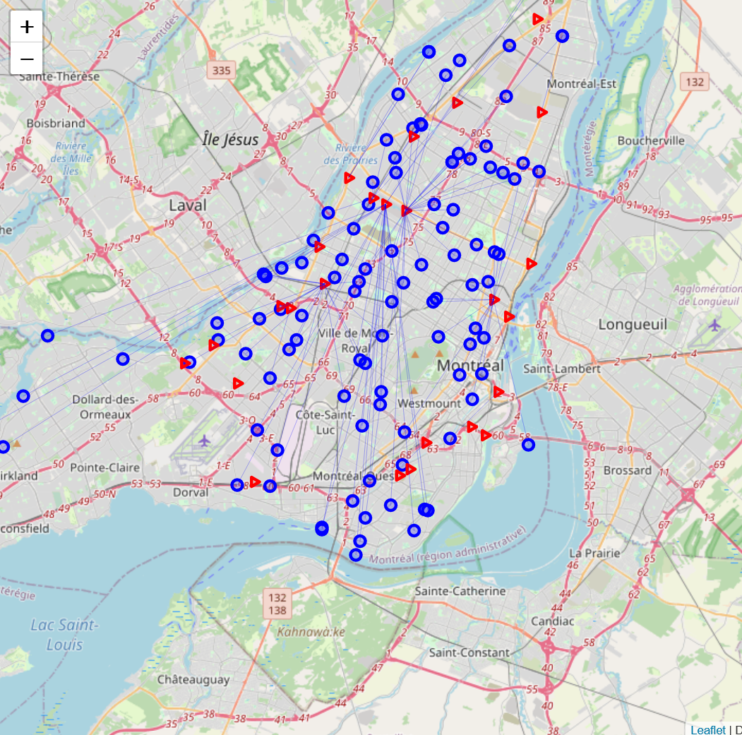
The Snow Removal Challenge in Montreal
Transportation Challenge:
Movement of snow from 106 pickup sectors to 26 disposal sites.
Complex logistics due to diverse urban landscape.
Objective:
Minimize total cost.
Map showing Pickup Sites (Circles), Disposal Sites (Triangles), Snow Transportation Path (Lines)

Slide 4
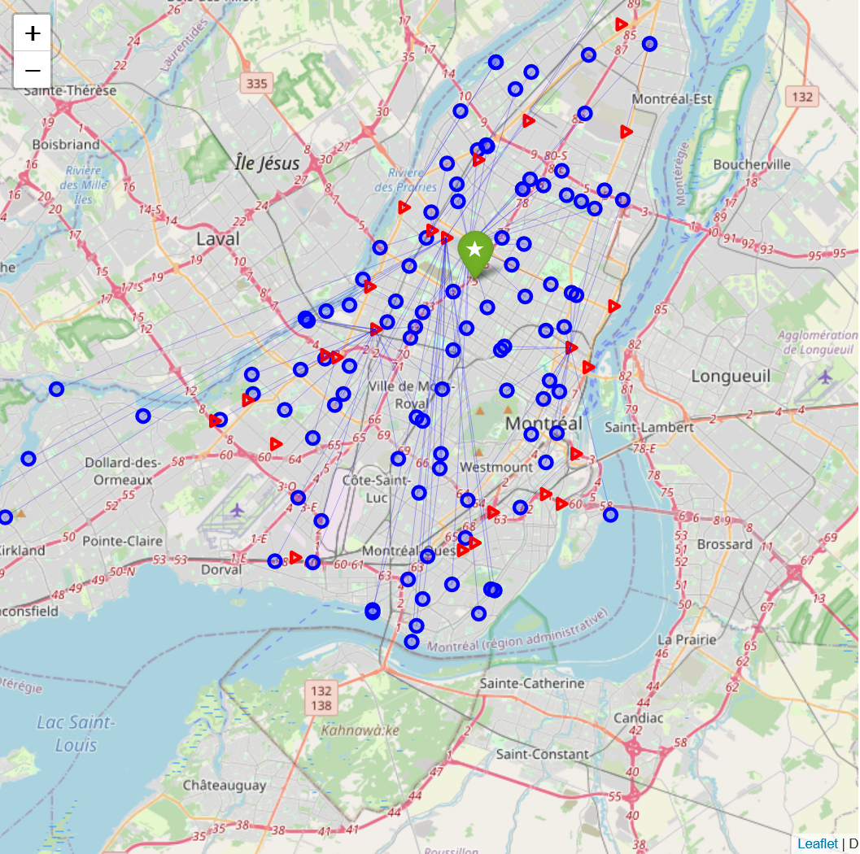
The Snow Removal Challenge in Montreal
Transportation Challenge:
Movement of snow from 106 pickup sectors to 26 disposal sites.
Complex logistics due to diverse urban landscape.
Objective:
Minimize total cost.
Find the most efficient hub location for operations.
Map showing Pickup Sites (Circles), Disposal Sites (Triangles), Snow Transportation Path (Lines)

Slide 5
Data Source
Data Sources:
Utilized Montreal Open Data portal and additional resources.
Key datasets: Snow Disposal Sites, Snow Removal Transactions, and Snow Removal Areas.
Dataset Overview:
Snow Removal Areas: Geospatial data on removal sectors and boroughs.
Snow Disposal Sites: Information on site types, capacities, coordinates, and volumes.
Snow Removal Transactions: Details on volumes transported, collection sectors, disposal sites, and timings.

Slide 6
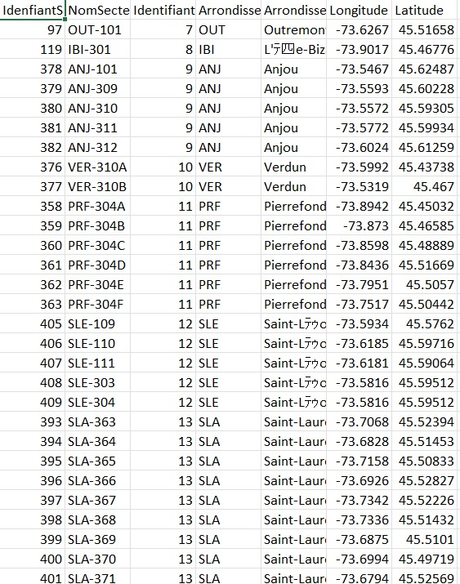
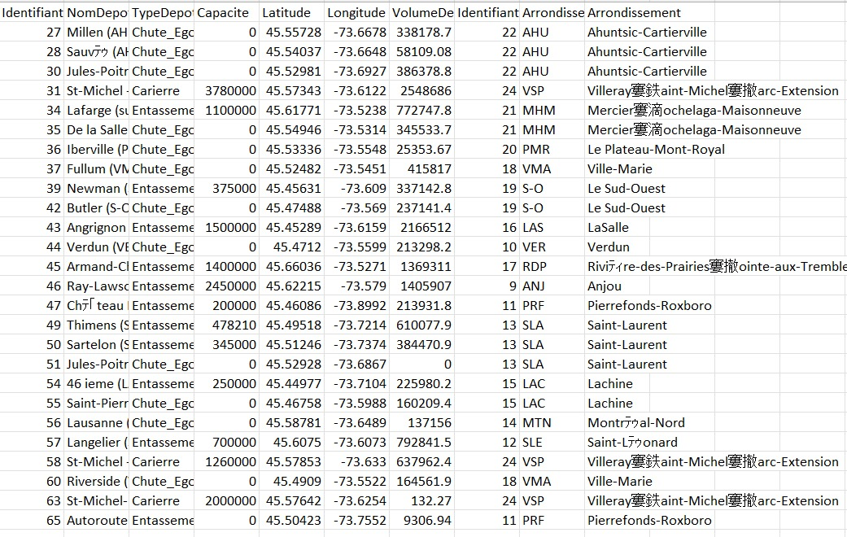
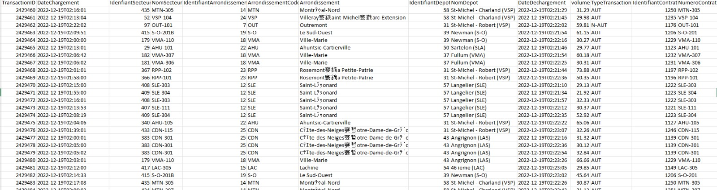
Data Source
Data Sources:
Utilized Montreal Open Data portal and additional resources.
Key datasets: Snow Disposal Sites, Snow Removal Transactions, and Snow Removal Areas.
Dataset Overview:
Snow Removal Sites: Geospatial data on removal sectors and boroughs.
Snow Disposal Sites: Information on site types, capacities, coordinates.
Snow Removal Transactions: Details on volumes transported, collection sectors, disposal sites, and timings.
Removal Sites
Disposal Sites
Transactions

Slide 7
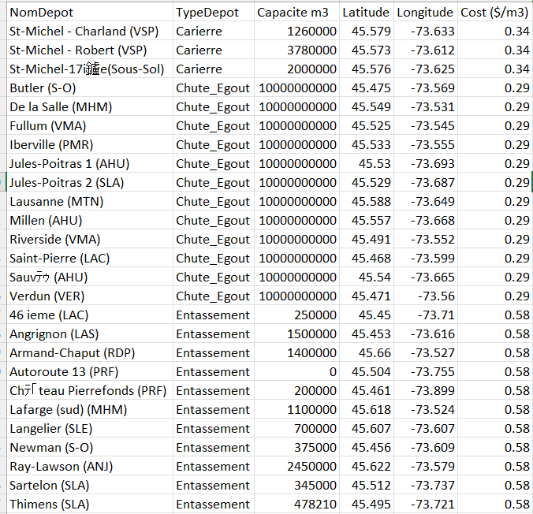
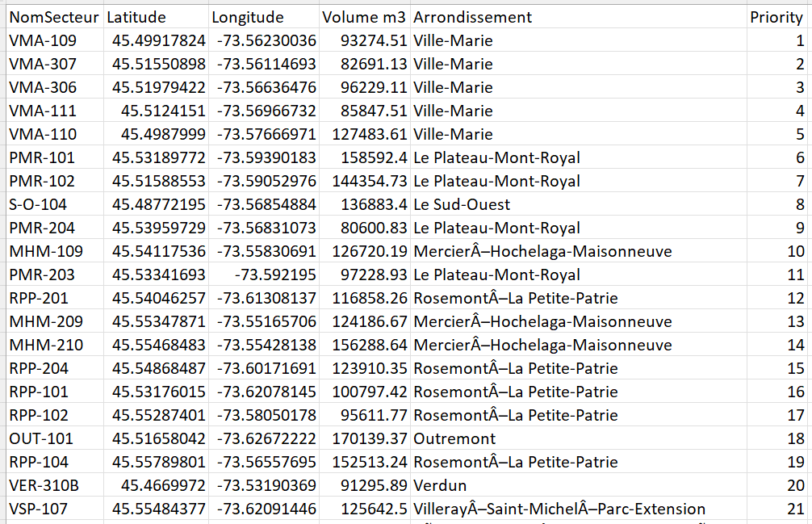
Preprocessing
Data Preprocessing:
Calculated total snow to be removed from Pickup site based on transactions.
Derived snow elimination costs from various disposal sites using research data (source).
Final Output:
Consolidated datasets into two main files for model use - Pickup Sites, Disposal Sites.
Disposal Sites
Pickup Sites

Slide 8
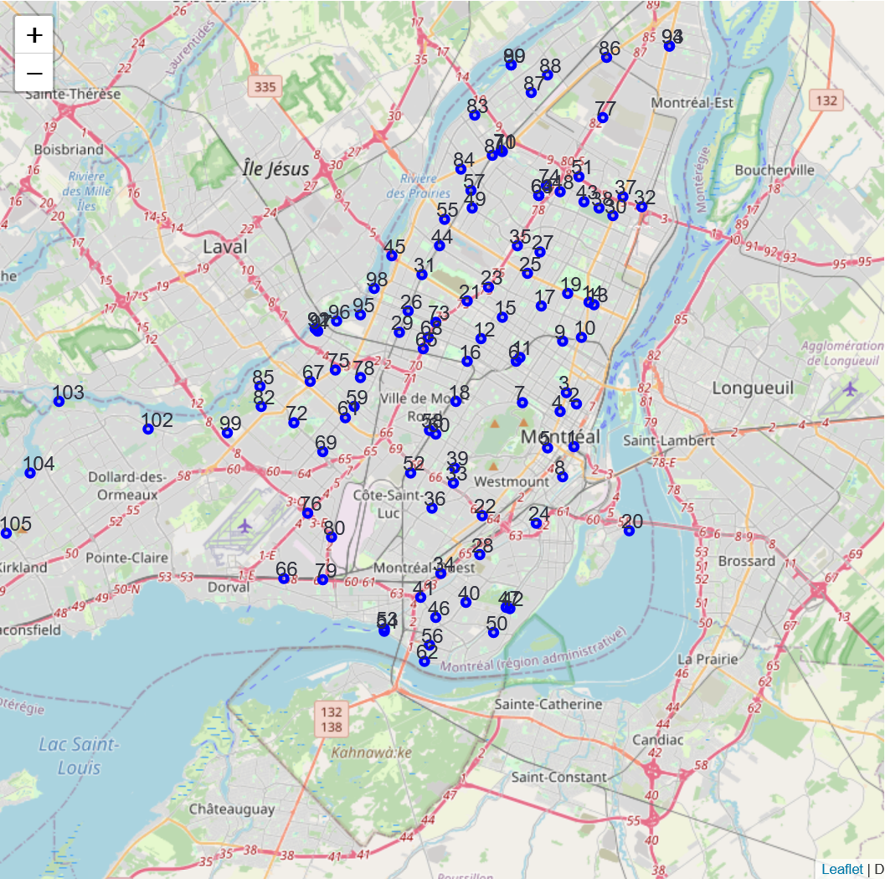
Assumptions
Trucks: There is a single truck with unlimited capacity – data not available.
Path: Within a day, the truck follows a routine of traveling from the hub to the pickup site, disposing of the snow, and returning to the hub. (This simulation mirrors a real-life scenario where workers return to the hub at the end of the day to park the trucks).
Priority: The truck adheres to a priority order based on proximity to downtown when determining the sequence in which it will travel to the pickup sites.
Lower Priority Number indicates more priority

Slide 9
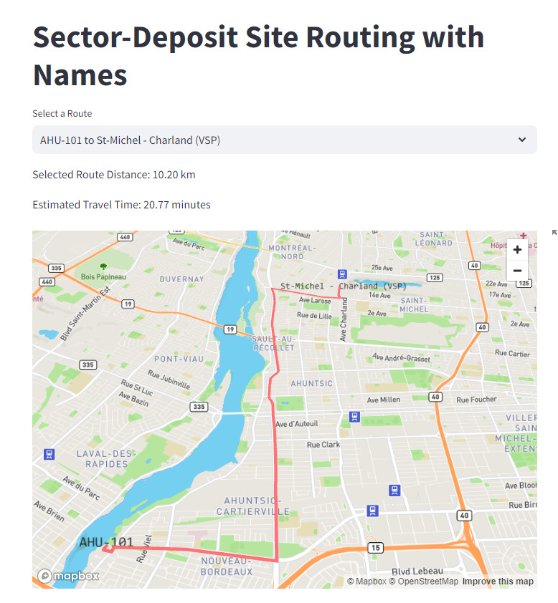

Obtaining Distances
Beyond Simple Distance Measures:
Avoided using Euclidean or Manhattan distance methods.
Real-Time Road Distances:
Employed MapBox API for calculating actual road distances.
This approach accounts for real-world travel conditions and routes.
Demo
Road Distance Example

Slide 10
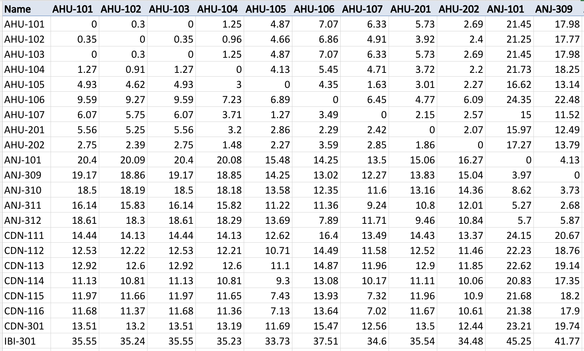
Distance Calculation Output
Beyond Simple Distance Measures:
Avoided using Euclidean or Manhattan distance methods.
Real-Time Road Distances:
Employed MapBox API for calculating actual road distances.
This approach accounts for real-world travel conditions and routes.
Demo
Site to Site Distance

Slide 11
Distance Function Formula
Distance Calculation:
Total distance = Distance from hub to pickup site + Distance from pickup site to disposal site + Return distance to the hub.
Components Explained:
From Hub to Pickup Site: Initial leg of the journey, where trucks travel from the hub to the snow removal sectors.
From Pickup to Disposal Site: Critical segment involving transportation of snow from pickup sectors to disposal facilities.
Return to Hub: Final leg, where trucks return to the hub, completing the cycle.
Purpose of Calculation:
Ensures realistic assessment of operational logistics.
Key to optimizing routes for cost and time efficiency.

Slide 12
Total Cost Calculation
Cost Components: $/m³)
Total Cost = Disposal Cost + Transportation Cost
Disposal Cost : ($/m³)
Cost of eliminating snow,
Dependent on the type of disposal site.
Derived from the paper.
Transportation Cost : ($/m³)
α ×(Distance)+β
Where α=0.1395, and β=0.513 for the city of Montreal.
Formula based on paper.

Slide 13
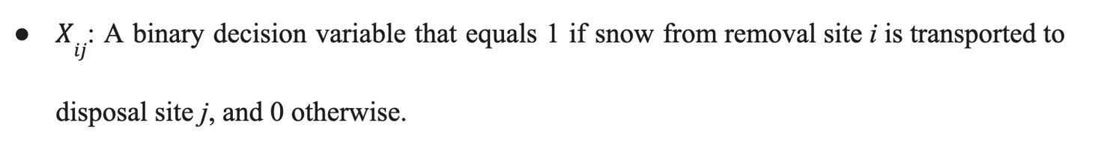
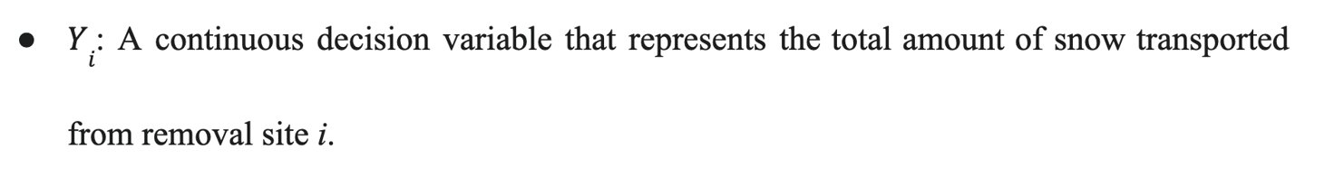
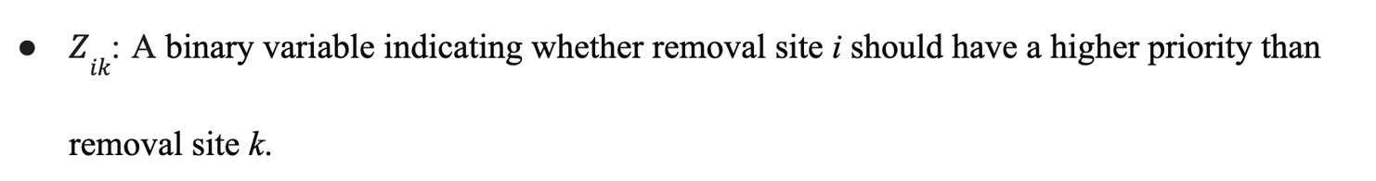
Decision Variables

Slide 14
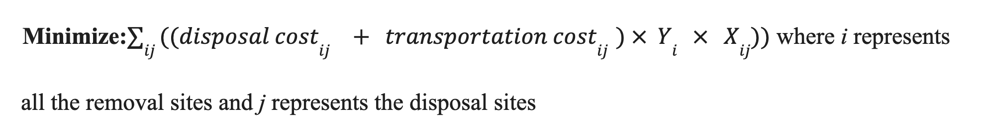
Objective Function

Slide 15
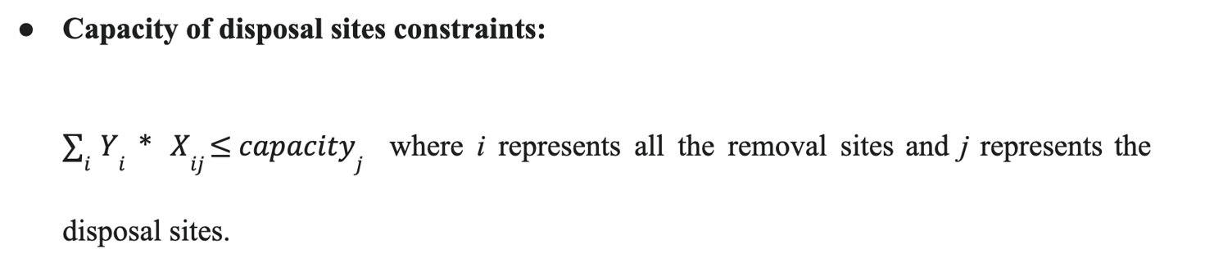
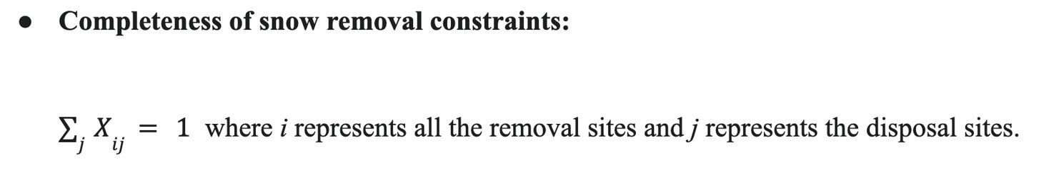
Constraints (Total 5400)

Slide 16
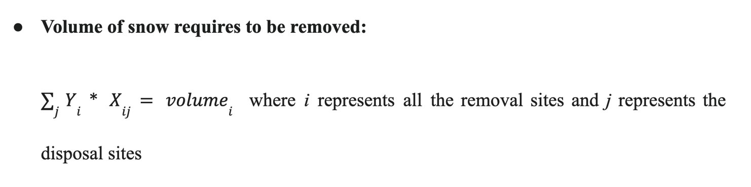
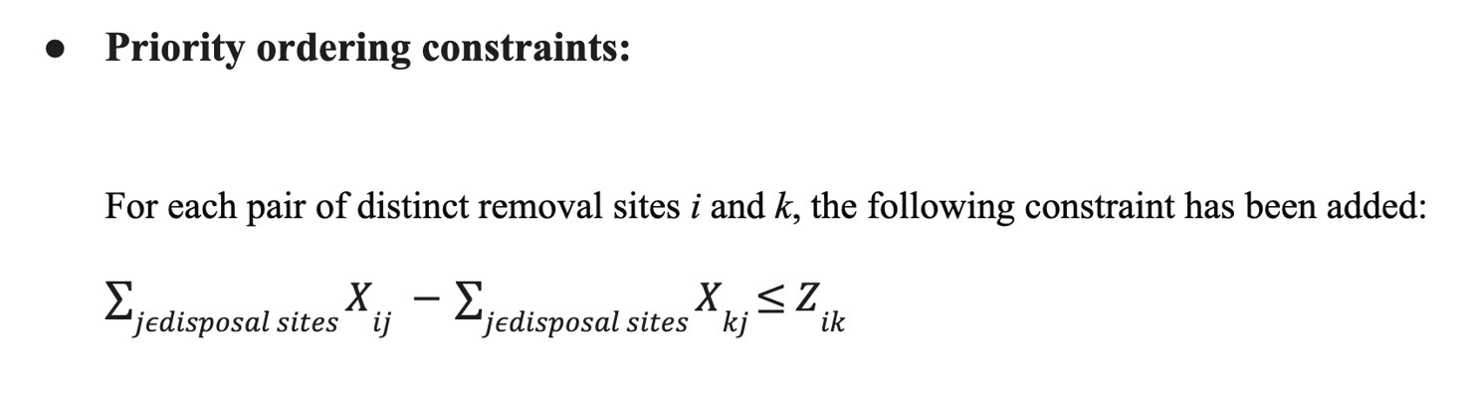
Constraints

Slide 17
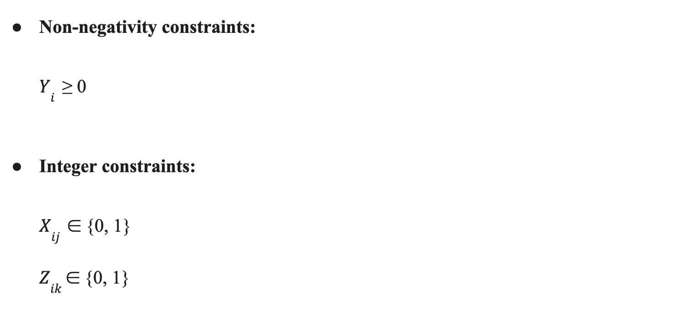
Constraints

Slide 18
Results - Changing Hub
Scenario | Central Hub Location | Total Cost ($) | Percentage Difference From Closest Hub
Closest Hub | VMA-109 (Ville-Marie) | $57.04 Million | -
Furthest Hub | IBI-301 (L'Île-Bizard–Sainte-Geneviève) | $121.77 Million | +113.5%
Middle Point Hub | LAS-326 (LaSalle) | $53.23 Million | -6.7%
Cost Variation: The furthest hub location more than doubles the costs compared to closer hubs.​
Most Economical Option: A centrally located hub is the most cost-effective solution.​
Impact of Hub Location: Costs at the furthest hub are over 113.5% higher.​
Strategic Planning: A central location favors cost efficiency and accessibility.​
Demo of Output
Hence, we decided to run a loop to find the optimal hub – problem extension.

Slide 19
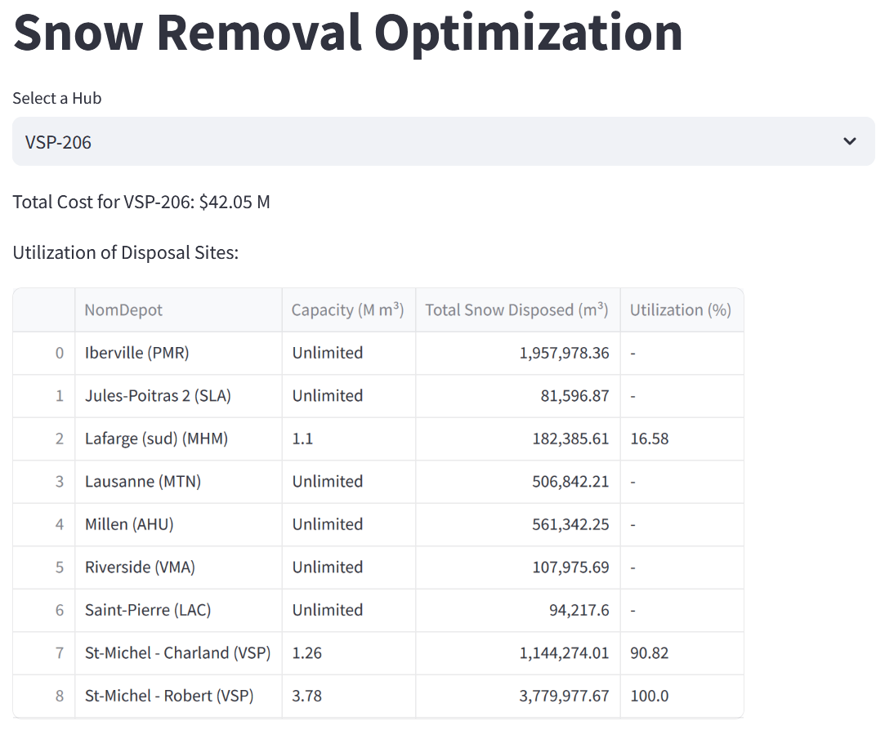
Results – Optimal Hub
Ran a loop through all hubs
Optimal Hub: VSP-206
Location and Characteristics:
Borough: Villeray–Saint-Michel–Parc-Extension
Location: Near mid-point between farthest and closest sites to Downtown.
Strategic Placement: Balances distance to various removal and disposal sites.
Cost Efficiency:
Total Cost for Snow Removal: Approximately $42.05 million.
Significantly lower than other scenarios, indicating high-cost efficiency.
Advantages Over Other Scenarios:
More cost-effective compared to both closest and furthest hub scenarios.
Improved operational efficiency, potentially saving time and resources.
Demo

Slide 20
Problem Extensions
Environmental Impact Assessment:
Integrate environmental factors into the optimization criteria.
Certain Disposal sites like sewers have unlimited capacity but greater environmental impact.
Multi-Objective Optimization:
Expand the model to address multiple objectives beyond cost minimization.
Focus areas could include minimizing environmental impact, improving response times to critical removal sites, and ensuring equitable snow removal across different neighborhoods.
Limited number of vehicles, multiple hubs, vehicle scheduling, salt-based snow removal
Consider the integration of live traffic data to enable real-time adjustments to routes, addressing immediate road conditions and congestion.
Consider time-based snow variation.
Real Life Complexities:

Slide 21
Q&A

